Slide 1

MATC Smart Barrier – Path Generation
Ricardo Jacome
Midwest Roadside Safety Facility
University of Nebraska-Lincoln
Pool Fund Sample Presentation
4/15/2019

Slide 2
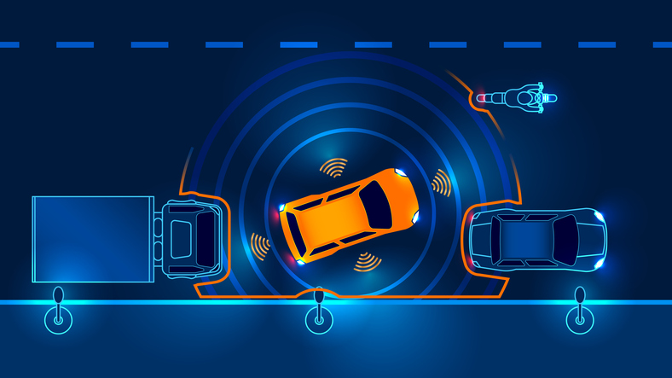
Autonomous Vehicle Evolution
To Drive Autonomously:
Based on SAE Recommended Practice J3016 from 2018.
Dynamic Driving Tasks (DDT)
Steering/Avoidance
Braking/Accelerating
Automated Driving Systems (ADS)
Levels 0,1,2 – Driver Performs DDT’s
Level 3,4,5 – ADS Performs DDT’s
From 2000 and 2018, Level 4 has been reached.

Slide 3
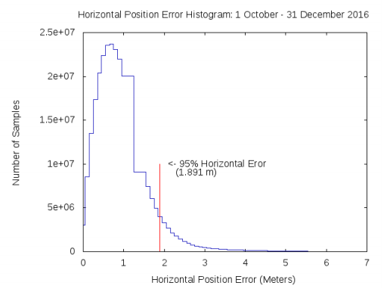
Limitations: Sensors
On GPS
From Federal Aviation Administration:
On May 11, 2016, the reported global average User Range Error was ≤0.715 m (2.3 ft.), 95% of the time.
This Error is Enough to have a Vehicle off the Road
On Object Detection
Tencent Keen Security Lab
On March, 2019, Tesla’s Autopilot was tested for Lane Detection accuracy, and mistook stickers for lane marks.
Conclusions: Level 5 is not yet a reality
Notes:
https://www.gps.gov/systems/gps/performance/accuracy/
https://electrek.co/2019/04/01/tesla-autopilot-hacker-tricked/

Slide 4
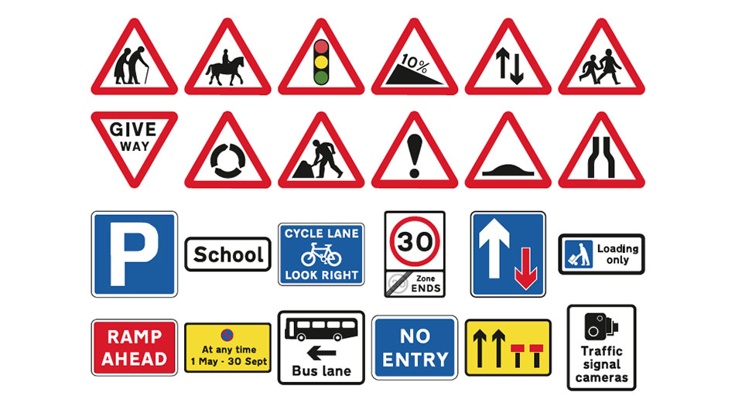
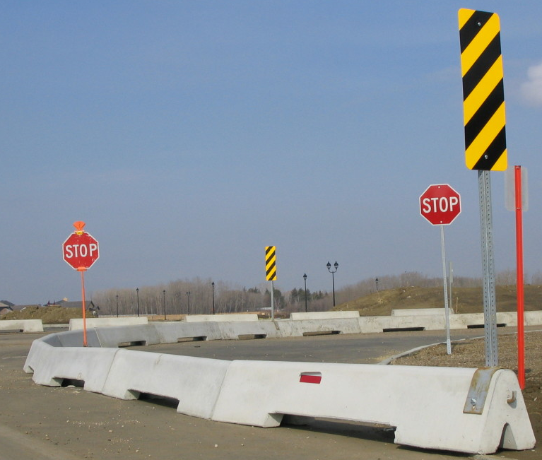
What’s Missing?
Current Vehicle Technology is Focused on using Current Infrastructure made for humans
Current Infrastructure is not made for autonomous vehicles
Infrastructure can evolve to adapt to new Vehicles

Slide 5
MATC SMART Barrier
Project of 3 Main Parts Consisting of
Updates on Infrastructure for:
Local Trilateration
Local Path Generation
Modular Vehicle Navigation

Slide 6
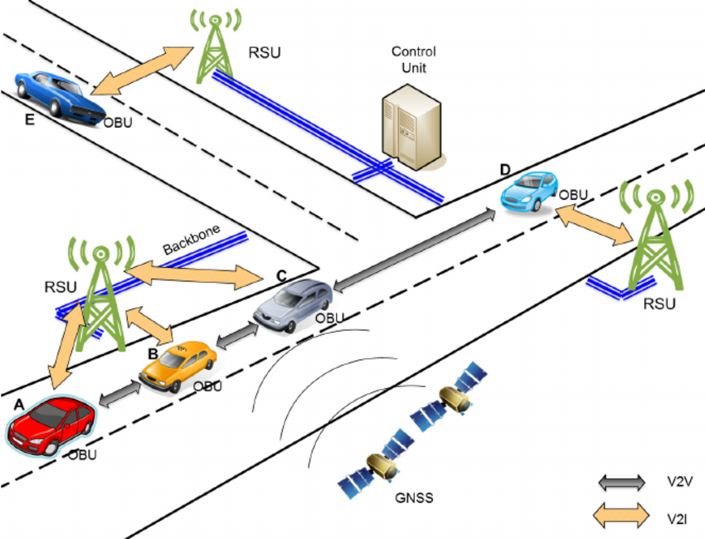
Local Trilateration
Vehicle to Infrastructure (V2I) Communications
RSU Roadside Units
Local GPS Location
OBU On-Board Unit
Vehicle Information Transfer
Objective: Find Vehicle Position in Local Frame
Notes:
Sanguesa, J. Sensing Traffic Density Combining V2V and V2I
Wireless Communications

Slide 7
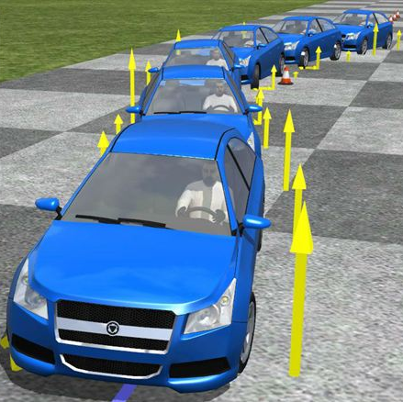
Local Path Generation
Once Establishing a Local Position:
Use Off-line Data
To reduce computation cost on OBU
Local Path Generation
Send in the Form of Steering Wheel Angle
Objective: To Generate a Path with the Smallest Storage Cost Possible

Slide 8
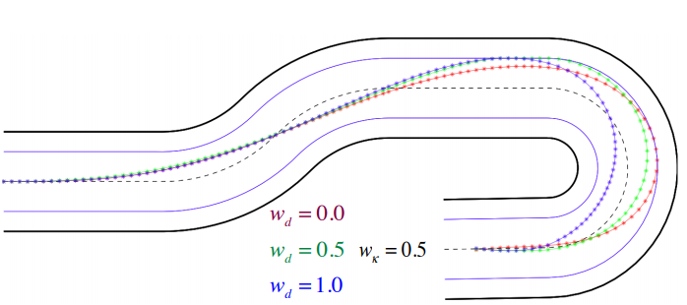
Modular Vehicle Navigation
Adjust Path for Individual Vehicles
Vehicle guidance is dependent on vehicle parameters
Unique Paths need to be generated per vehicle data

Slide 9
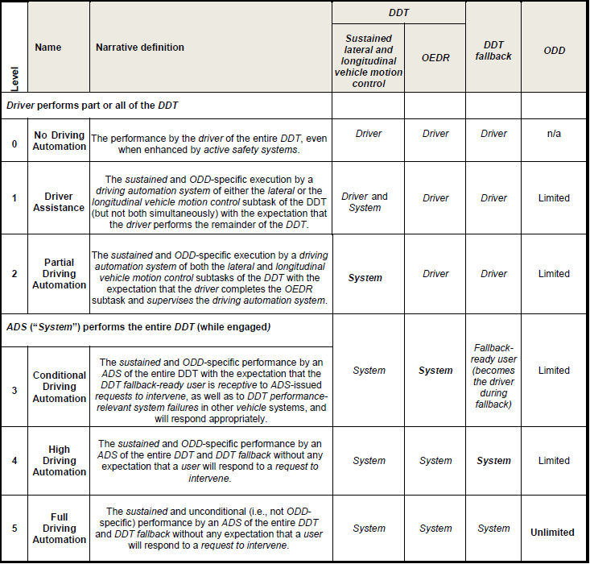
Taxonomy of Levels

Slide 10
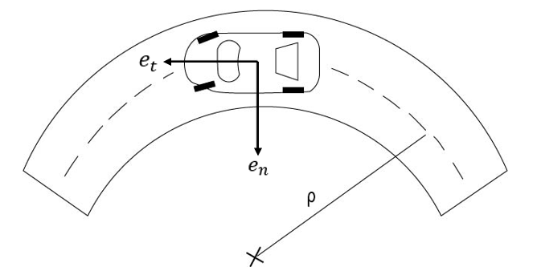
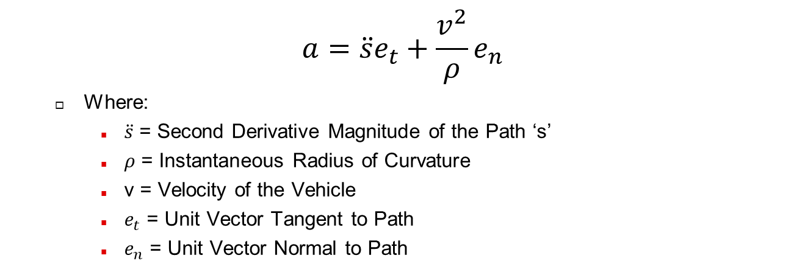
Normal-Tangential Accel.
Vehicle Centerline
$$a=\ddot{s}e_{t}+\frac{v^{2}}{ρ}e_{n}$$
Where:
$\ddot{s}$ = Second Derivative Magnitude of the Path ‘s’
$ρ$ = Instantaneous Radius of Curvature
v = Velocity of the Vehicle
$e_{t}$ = Unit Vector Tangent to Path
$e_{n}$ = Unit Vector Normal to Path

Slide 11
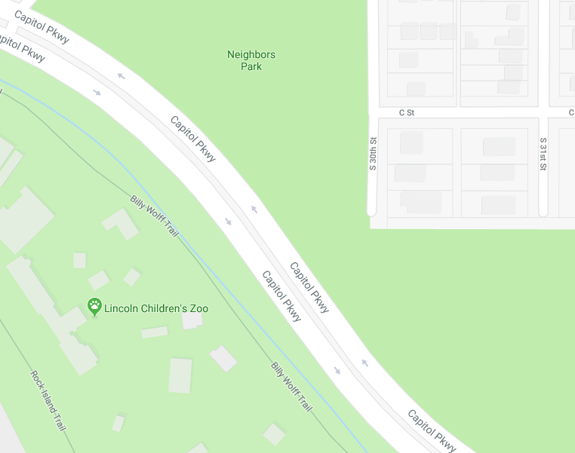
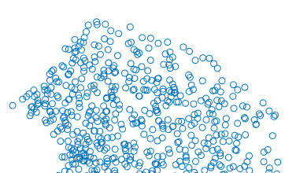
Road Sampling Example

Slide 12
Road Slicing

Slide 13
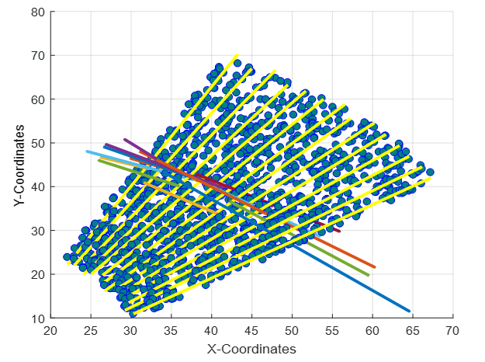
Multiple Sections of Slices

Slide 14
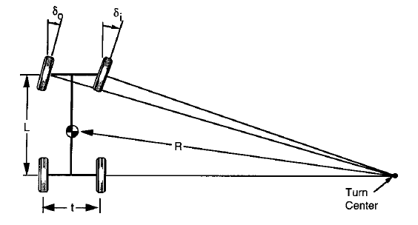

Ackerman Steering
At low speeds, this geometric relationship holds true:
$$δ=\frac{L}{ρ}$$
For Ackerman Steering, it is assumed that the value is an average of both wheels together.
Notes:
Images from Fundamentals of Vehicle Dynamics – Thomas D. Gillespie

Slide 15
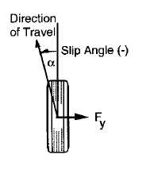
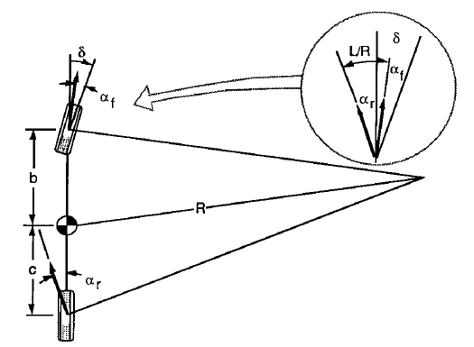
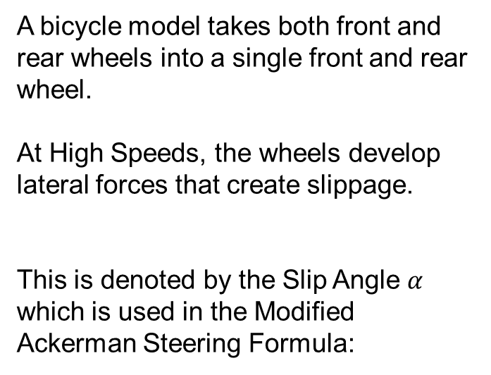
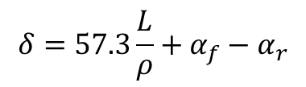
Modified Ackerman Steering
A bicycle model takes both front and rear wheels into a single front and rear wheel.
At High Speeds, the wheels develop lateral forces that create slippage.
This is denoted by the Slip Angle $α$ which is used in the Modified Ackerman Steering Formula:
$$δ=57.3\frac{L}{ρ}+α_{f}−α_{r}$$
Notes:
Images from Fundamentals of Vehicle Dynamics – Thomas D. Gillespie

Slide 16
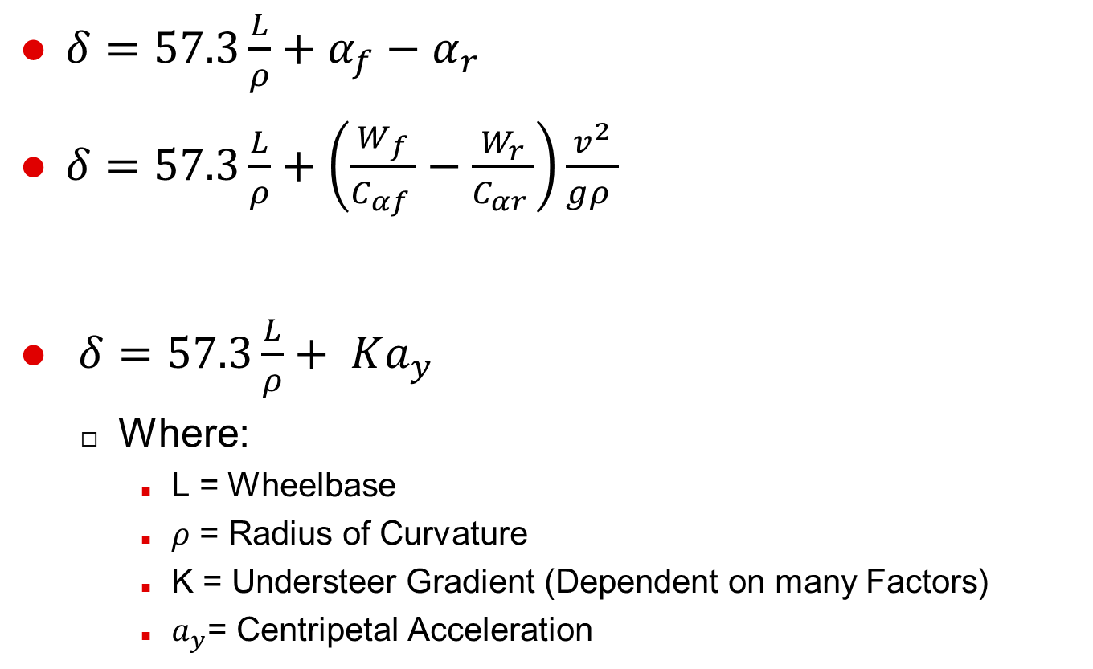

Steering Gradient Factors
$δ=57.3\frac{L}{ρ}+α_{f}−α_{r}$
$δ=57.3\frac{L}{ρ}+\left(\frac{W_{f}}{C_{αf }}−\frac{W_{r}}{C_{αr }}\right)\frac{v^{2}}{gρ }$
$δ=57.3\frac{L}{ρ}+ Ka_{y}$
Where:
L = Wheelbase
$ρ$ = Radius of Curvature
K = Understeer Gradient (Dependent on many Factors)
$a_{y}$= Centripetal Acceleration
$$K{ a}_{y}$$
Notes:
L = Wheelbase of Vehicle
V = The velocity of the vehicle
Rho = Instantaneous Radius of Curvature
Wf = Distributed Front Weight of Vehicle
Wr = Distributed Rear Weight of Vehicle
Caf = Cornering Stiffness of the Front Tires
Car = Cornering Stiffness of the Rear Tires
G = Gravitational Acceleration Constant

Slide 17
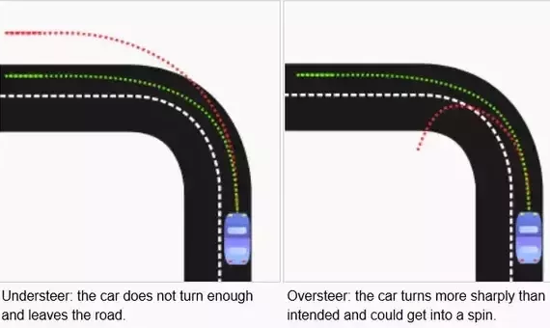
Steering Gradient Behavior
$K>0 →Understeer$ $K<0 →Oversteer$

Slide 18
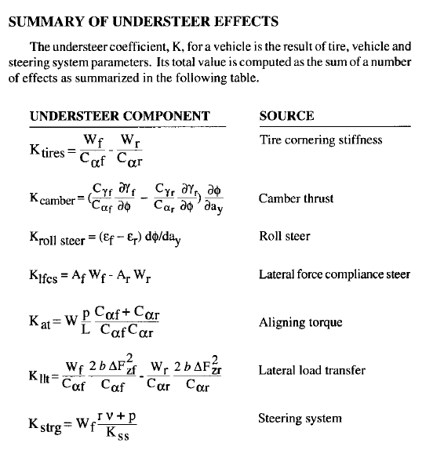
Hidden Slide

